Slide 1


Slide 2
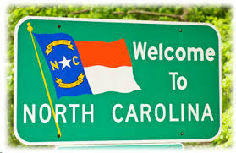
INTRODUCTION
Presented by:
Kelby Wilson
Joseph Scott
Inna Gurevitch
Hope Meeme

Slide 3
The Story of the Data
We decided to explore the safety conditions of the North Carolina Roads and what it means for the people living there or considering to relocate there.
With this being said we did an exploration of their pedestrians crashes and the bikes crashes recorded by the NCDOT( North Carolina Department of Transportation).
This was also driven to determine which outdoor activities are safe to partake in the state on the roads, walking or cycling.
We used some of the new techniques and skills we learned to explore the data, clean it and then to create different visualizations.

Slide 4
Data

Slide 5
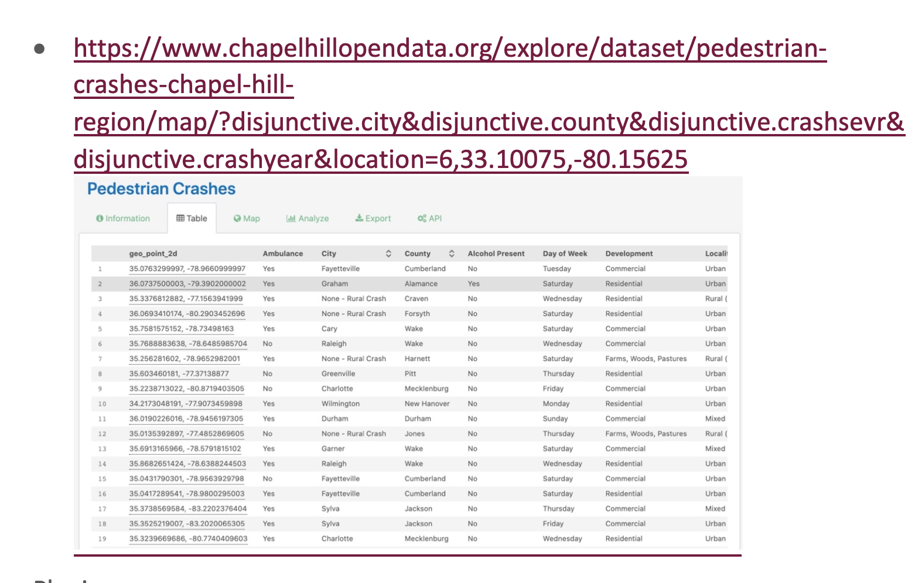
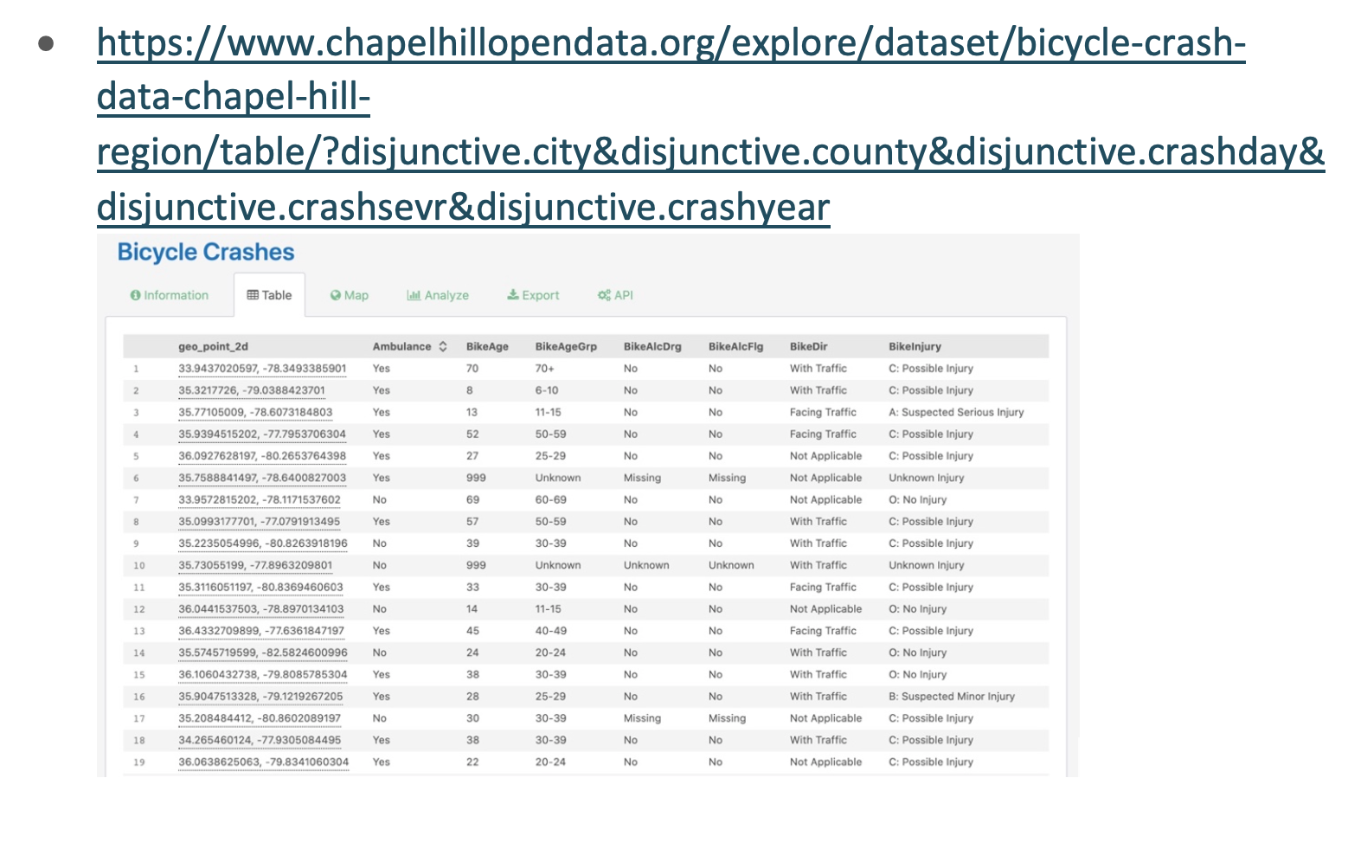
Data Source

Slide 6
Data Cleanup & Exploration
Used jupyter Notebook, Pandas, Matplotlib etc.
Used Javascript
D3
Plotly
Map Leaflet plugins
Python flask
MongoDB

Slide 7
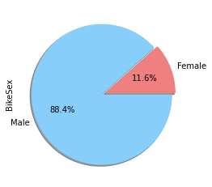
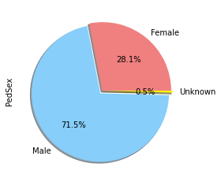
Crash Deaths by Gender(Bike and Ped)
Bicycle crash deaths by gender
Pedestrian crash deaths by gender

Slide 8
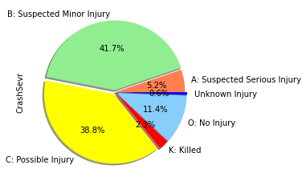
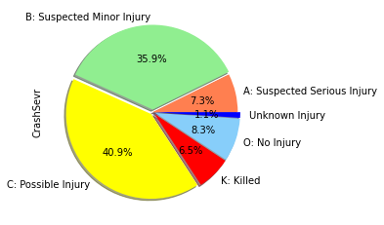
Crash Injury Severity(Bike and Ped)
Bicycle crash injury severity Pedestrian crash injury severity

Slide 9
WEB DESIGN

Slide 10
Web Design
The Structure
Landing page
Navbar (On every page)
Grid Layout
Map
About Page
Project Info
Data Page
Databases
Bicycles
Interactive Map
Pedestrians
Interactive Map
The Logic
Build Project
Create the folders
Add the folders
Connect the files
Navbar
Home link and 4 other links
Images
Logos
Animations
Javascript
Map
Link API

Slide 11
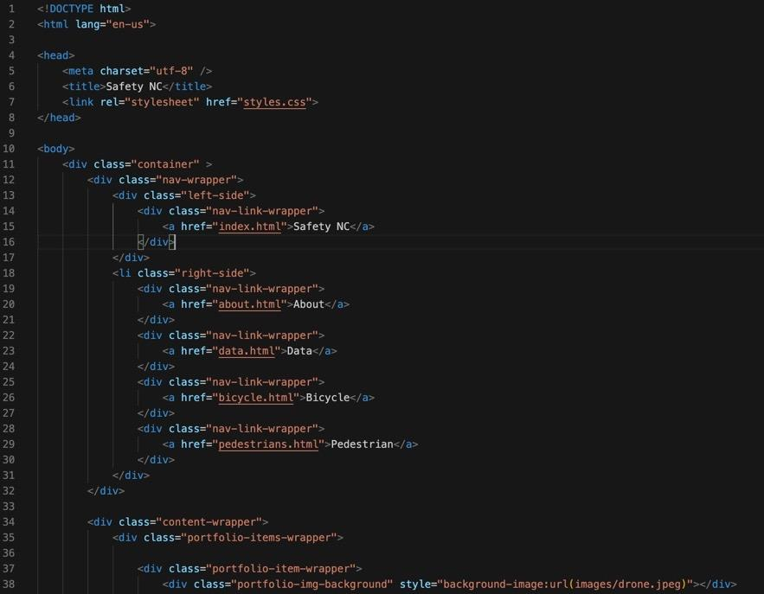
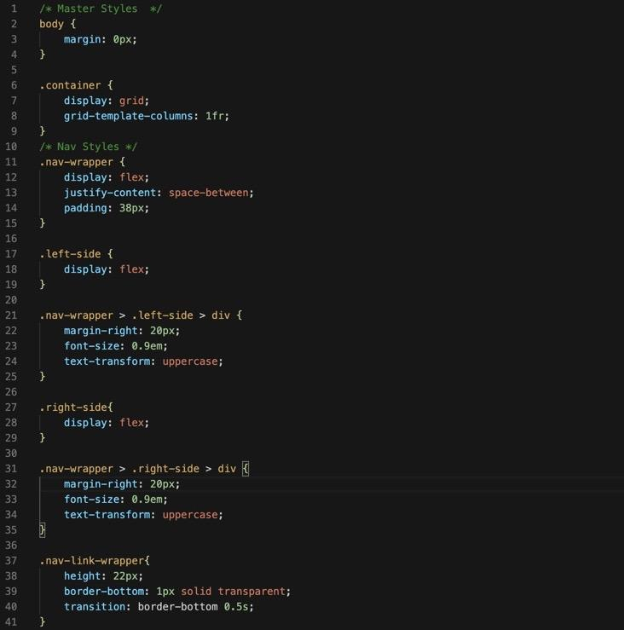
http://127.0.0.1:5501/Material/template/index.html

Slide 12
PROCESS/ARCHITECTURE

Slide 13
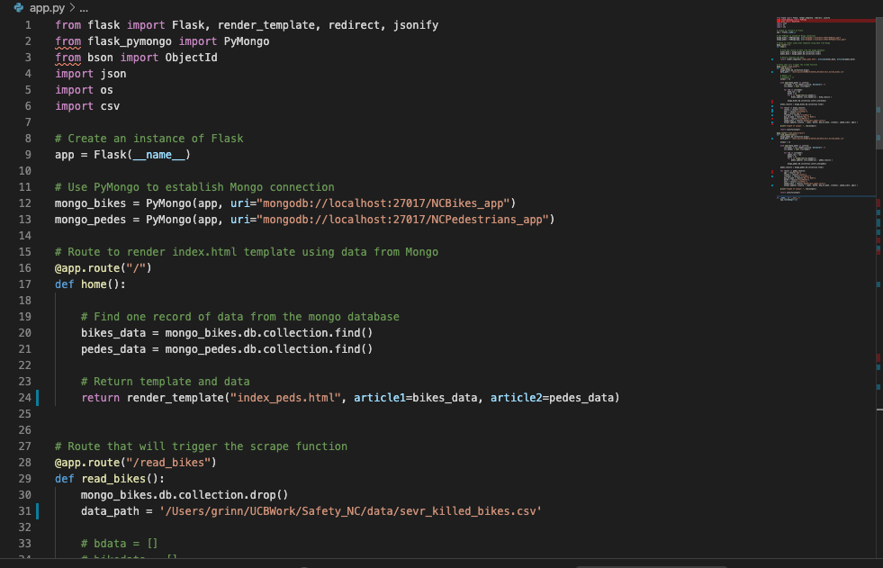
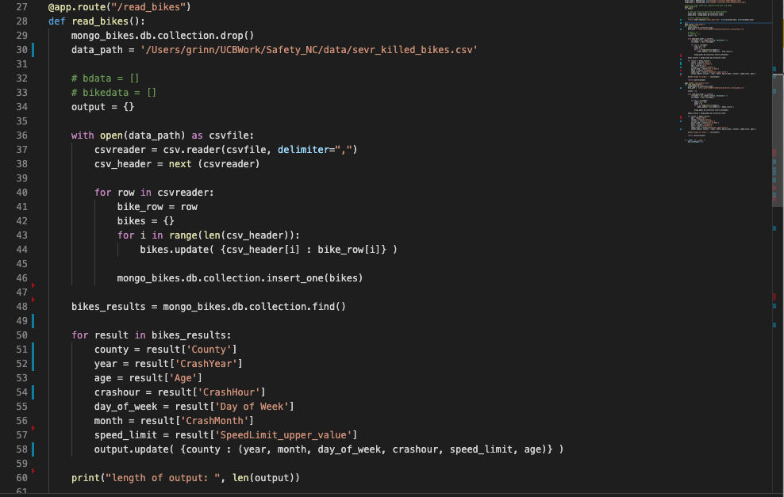
Python Flask Construction
Process flow:
Read, cleaned, parsed, dataset (from jupyter nb.)
Connect to MongoDB; then store, read and jsonify the output (Object).
Send data to the bikes-/ or pedestrians html pages.
Build JavaScript with D3 elements for the data visualization.
Victims from Bicyclists and Pedestrians, reported ‘crashed severity: killed’, were selected for the visualization.

Slide 14
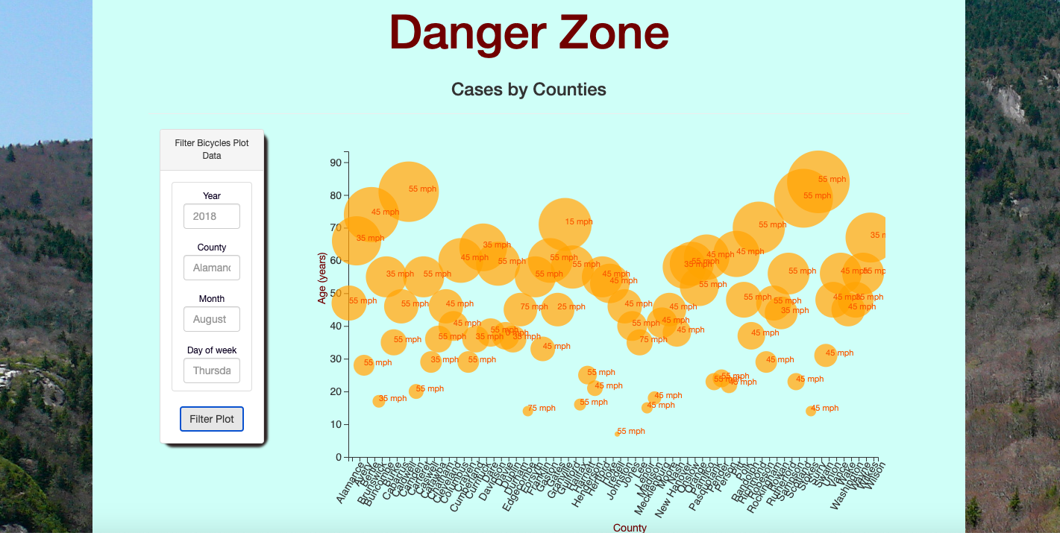
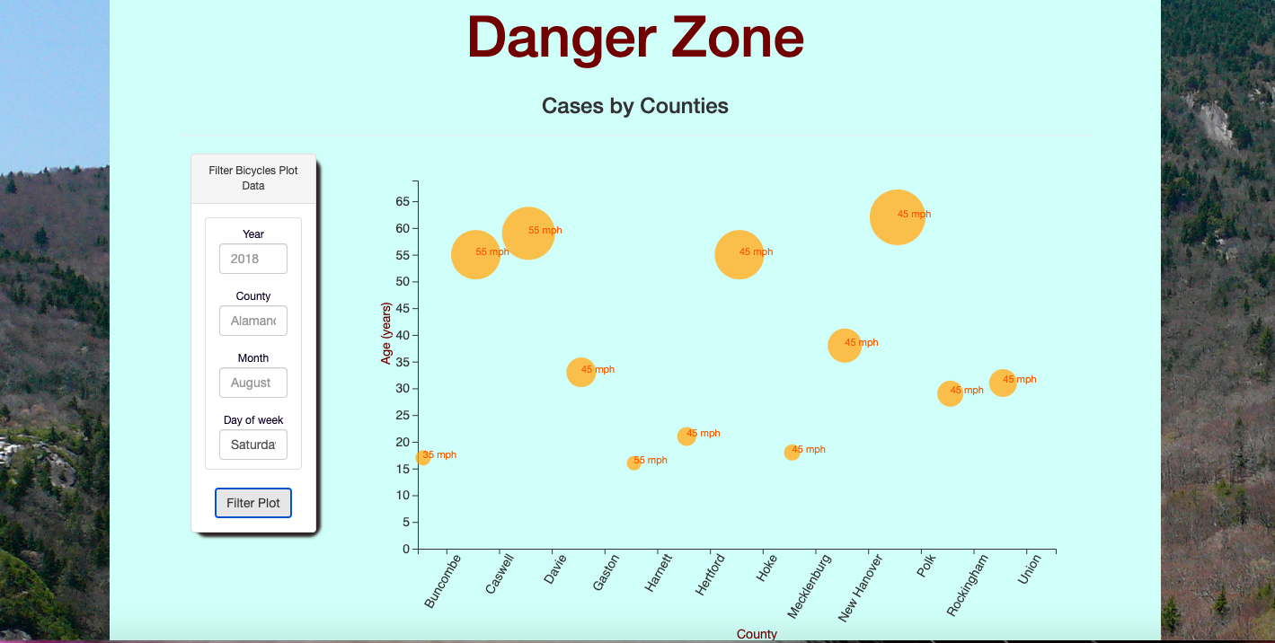
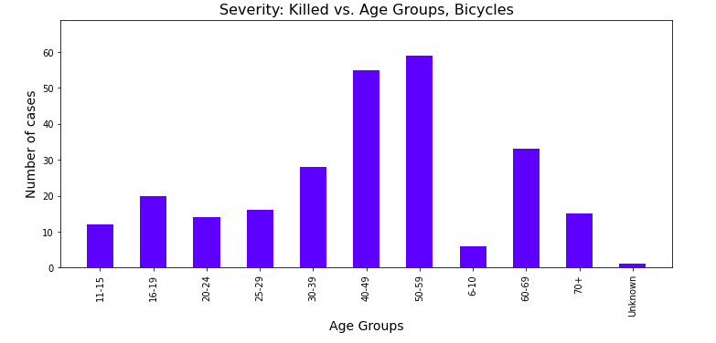
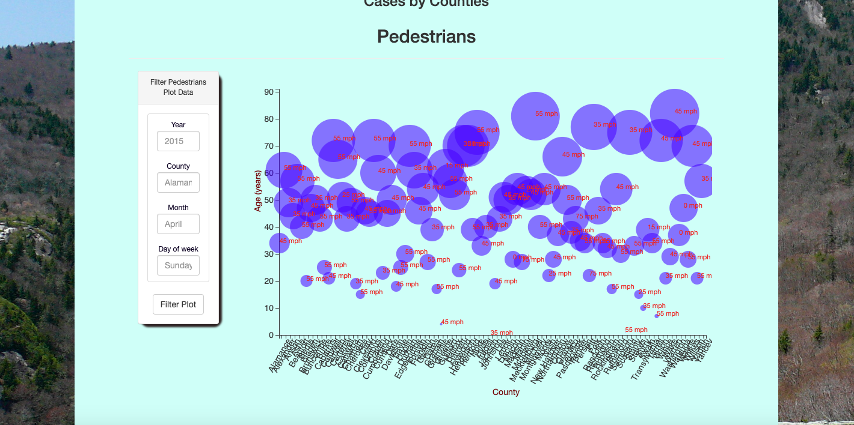
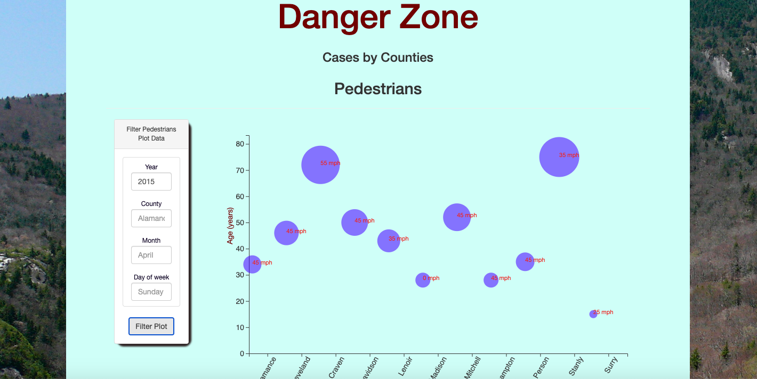
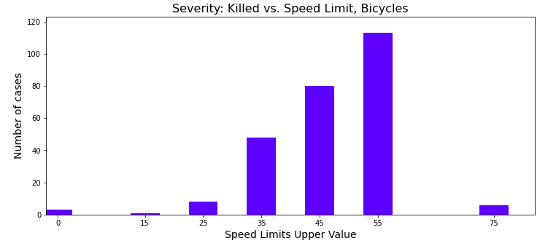
D3 Bubble Plots for Bicycles and Pedestrians
Available features: filter plot data
County
Year
Month
Day of week
Texting on circles shows Speed_Limit_Upper_Value (mph)

Slide 15
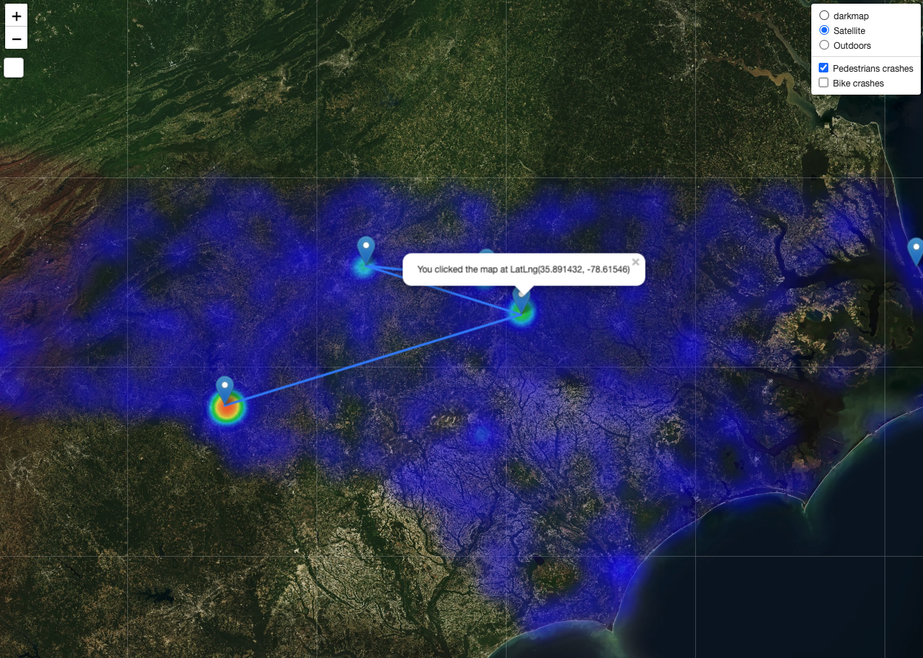
Data Analysis
Used map leaflet to analyze our data
Read through our GeoJson datafile to create the maps
Combination of heatmap with different map styles.

Slide 16
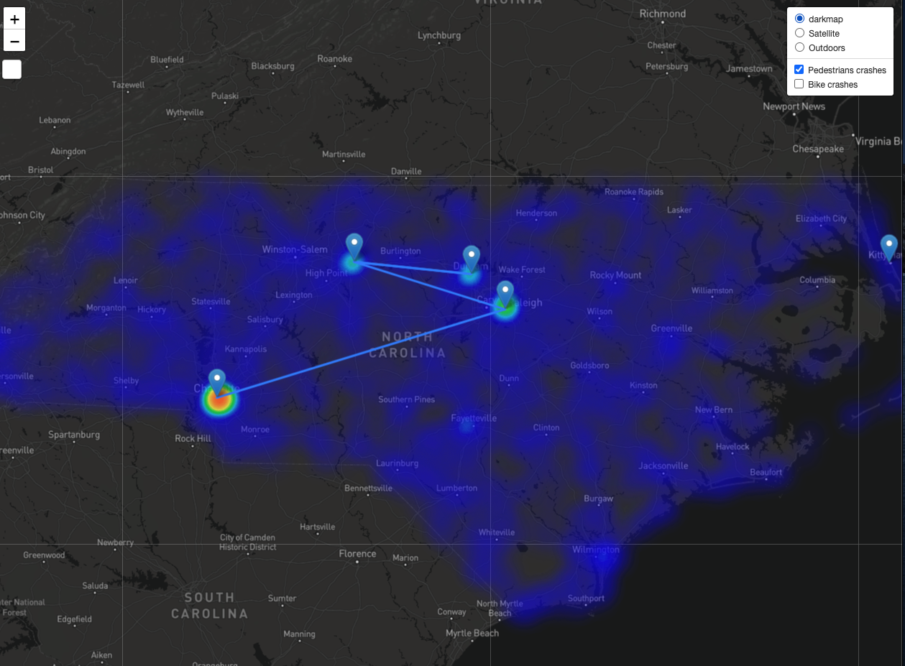
Leaflet cont.
Includes bindpopup with our Latlngs information
A control box plugin and a layer group plugin

Slide 17
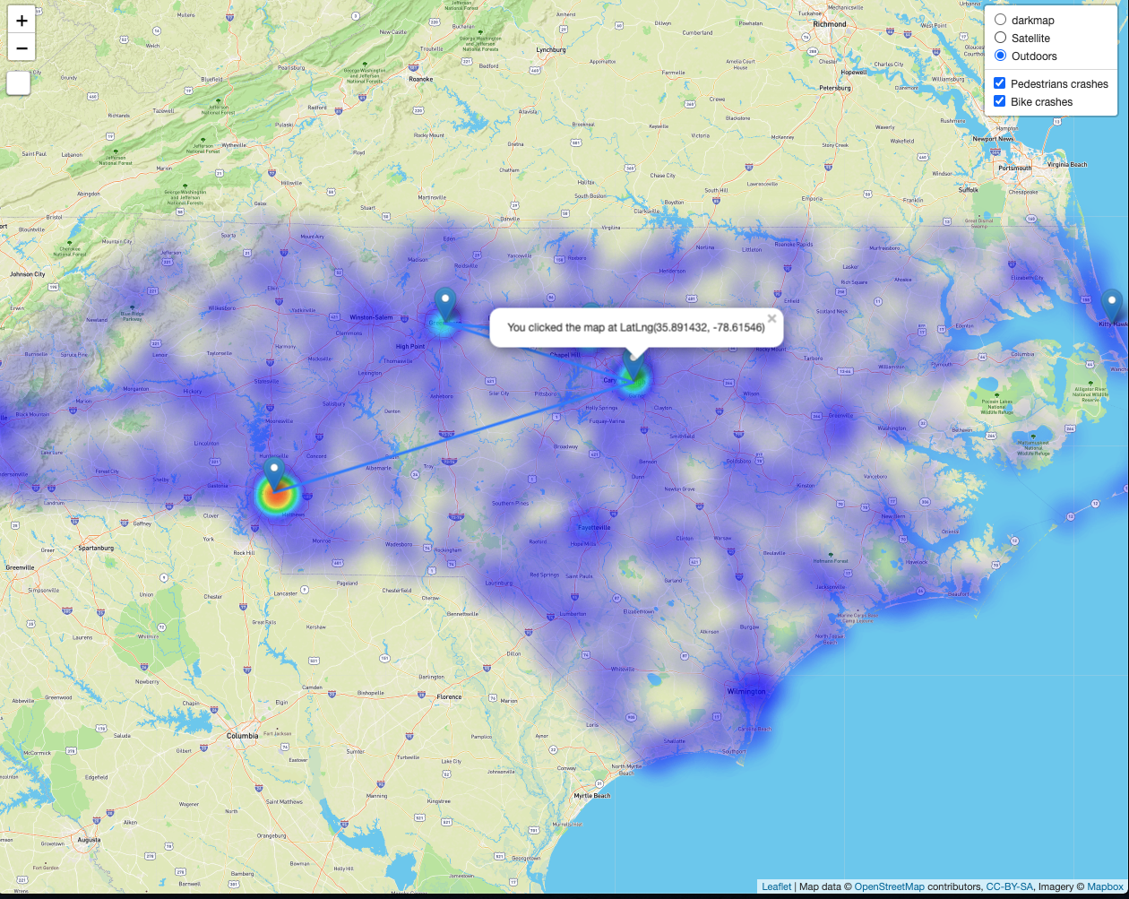
Leaflet cont.

Slide 18
Post Mortem
Trying to get a polyline snake animation plug in to work but all was in vain
Dealing with a huge dataset that includes commas in them and the process of cleaning them up and getting rid of the commas wasn’t fun.
Presenting two D3 interactive plots on one html page was not successful…(by using .js files; copying the second section on the same .js file)
If we had more time:
Merging two data set (bikes and pedestrians) to present two visualizations on one plot
Making multiple interactive y-axis on bubble plot

Slide 19
QUESTIONS?

